Slide 1
TACHYONIC_GLICH EWAM-an App based approach for E-waste management.
Team Members:
Anish Agarwal
Anshuman Priyadarshi
Kabeer Adlakha
Sajid Riyaz
Yash Kumar

Slide 2
Team Introduction
Team Members-
Anish Agarwal
Anshuman Priyadarshi
Kabeer Adlakha
Sajid Riyaz
Yash Kumar
Education-
Undergraduate 2nd year students
Experience-
Projects Completed-
Hostel Management App, Chatbot , Feature Phone, Twitter Post Filter, Money Manager Application.

Slide 3
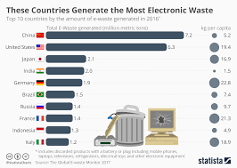
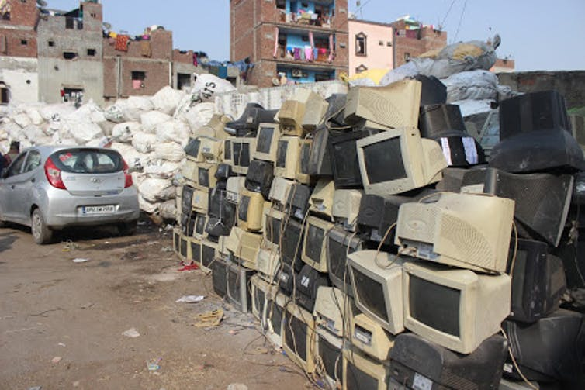
PROBLEM STATEMENT
Growing E-waste is a major problem in India. India generates more than 2 million tons of e-waste annually, and also imports undisclosed amounts of E-waste from other countries from around the world.
India is one of the major E-waste producing countries.

Slide 4
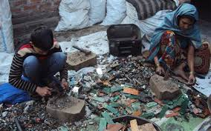
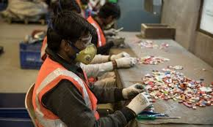
The formal sector is engaged in handling, recycling and reusing of Waste Electrical and Electronic Equipment (WEEE) in eco friendly way.
Informal Sector which consists of ragpickers recycle E-waste in conditions hazardous to their health and to the environment.
But more than 95% of India’s E-waste is processed by a widely distributed network of informal workers of waste pickers.

Slide 5
Our Solution
Our project is aimed at developing an application that intends to increase the flow of E-waste towards the formal sector for its efficient and eco friendly recycling , while integrating the informal sector in the process.
E-waste
EWAM Project
Formal sector

Slide 6
Value Proposition
Our innovation will target three different groups namely:
i) Producers of E-waste(private or public sector or household)
ii) ‘E-Waste collector’
iii) Formal sector facilities.
The value proposition for each of these will be-
For ‘Producers’- Producers will be attracted to the project as it will provide them with a simple application to sell their E-waste at a good price and at their own convenience . Also the producers will be assured that the E-waste generated by them will be managed properly without causing any harm to the environment.
For ‘E-waste collectors’-The value offered to ‘E-waste collectors’ is a safe, secure and respectable job which generates a regular income.
For ‘Formal sector facilities’-This is the group which will , perhaps, derive most value from our project. Due to our innovative idea the formal sector will be able to acquire e-waste which previously went to the informal sector(which is 95% of the total e-waste generated) ,thus witnessing a growth in its target customers by 20 times and hence in its profit.

Slide 7
CUSTOMER
Our Customers would include the following two groups-
Producers of E-waste(private or public sector or household) -
E-waste can be produced either by household or by public or private sector industries.
Formal Sector Facilities-
The Formal sector facilities are also the customers of our app.
Our solution is nothing but a simple app with a very interactive and easy to use interface. The customers will be able to perform actions on the app smoothly and without any difficulty.

Slide 8
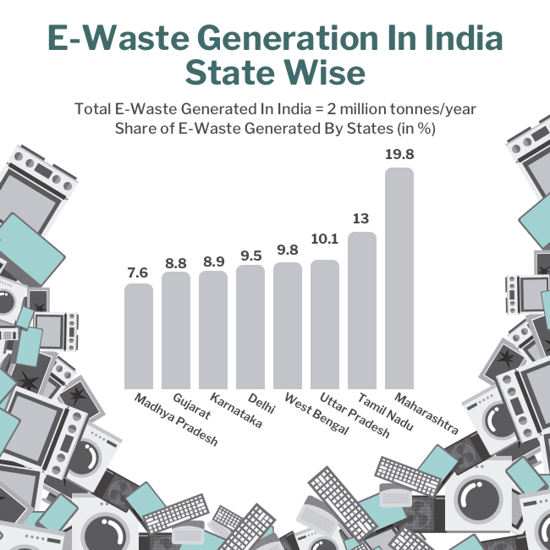
ADDRESSABLE MARKET-
Market consists of two parts-
B2C
B2B
The production of E-waste in humungous amounts allows for a market large enough to sustain the E-waste management business.

Slide 9



The amount of people owning electronic items is ever increasing. Also the rise of the IT industry leads to a very large customer base for our product.
PRODUCERS
EWAM
FORMAL FACILITIES
The formal facilities and the private and public sector industries will be the one using our innovation. While EWAM will be paying money to private and public sector industries to buy their E-waste, the formal facilities will be paying EWAM a part of the profit generated from recycling.

Slide 10
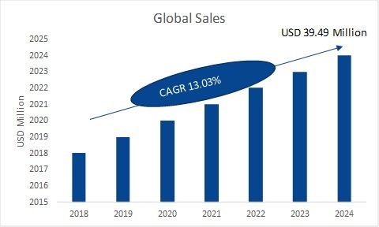
Global E-waste recycling market.
The global e-waste management market size was estimated at 44.7 million metric tons in 2016. It is projected to register a CAGR of 4.1% from 2017 to 2025.
Nationally the total market size is estimated at over $3 billion annually.

Slide 11
Market: Competition and Advantage
Major competitors
Ensyde
Zolopik
Direct Competition-
Ensyde- Environmental Synergies in Development (ENSYDE) is an organization with an aim to reduce the environmental footprint of organizations, establishments and institutions in India. We design and implement solutions that improve resource use efficiency – specifically energy, water and waste.
Zolopik- Zolopik collects and recycle all types of e-waste and batteries from large IT companies, Industries, schools, universities, and small and medium enterprises & households. The producers can fill a form on the zolopik website or give a call to a specified number

Slide 12
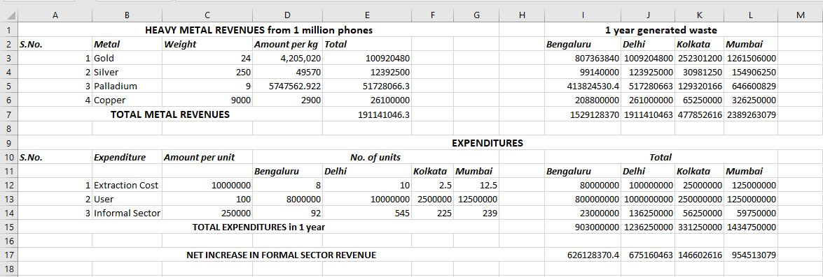
REVENUE STREAM
The revenue for the company would primarily come from the increased profit of the formal sector facilities.

Slide 13
COMPETITIVE ANALYSIS TOOL
Product/Prototype | Integration of informal sector | Transparency | Efficiency
EWAM | Yes | Yes | Yes
Ensyde | No | Yes | Yes
Zolopik | Yes | No | No

Slide 14
MARKETING CHANNEL
We will reach our customers by advertising the incentives and the value proposition of our project.
Initially word of mouth marketing will be our primary marketing strategy. Also we will market ourselves by sponsoring small events such as hackathons. Also we will give goodies to the customers on first use of our app.

Slide 15
MARKET SEGMENTATION
EWAM
Producer
E-waste Collector
Formal facility
App interface for the producer
App interface for the collector
App interface for the formal facility

Slide 16
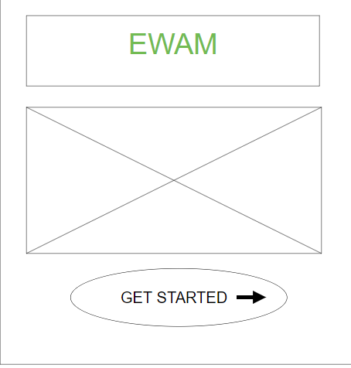
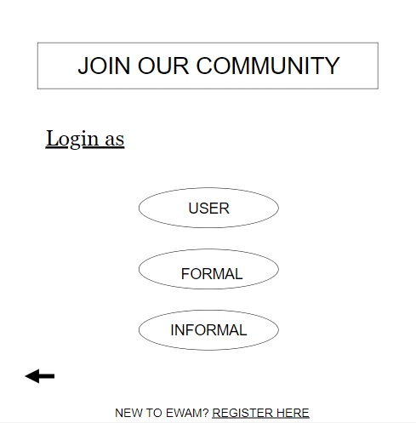
PRODUCT PROTOTYPE
Wireframes-

Slide 17
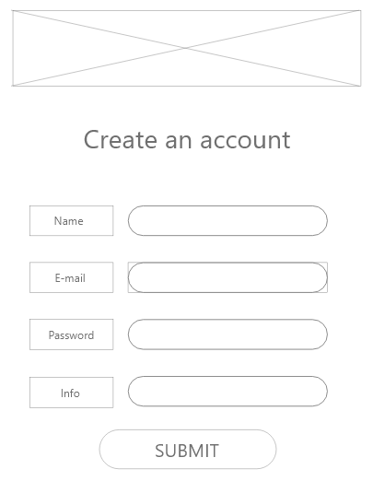
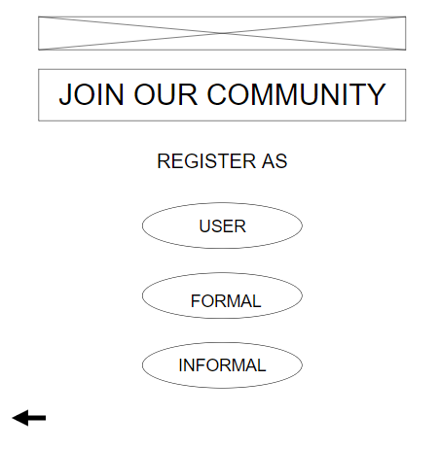

Slide 18
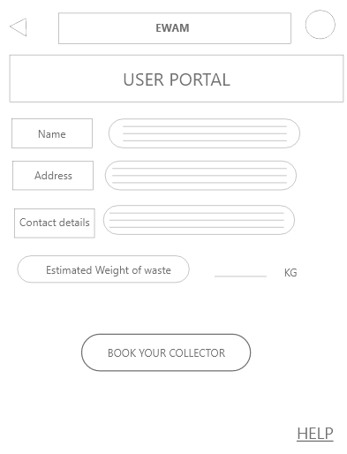
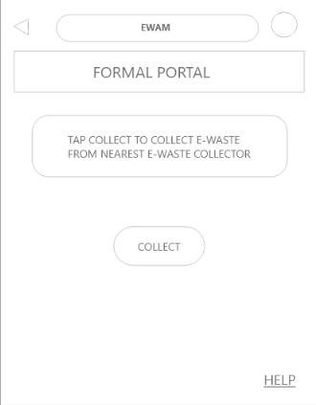

Slide 19
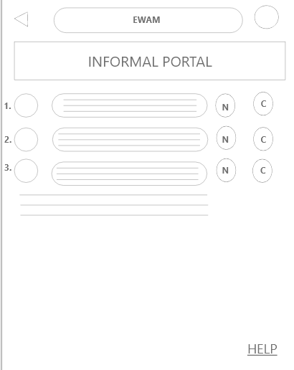
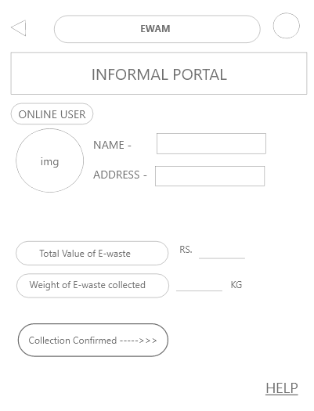

Slide 20
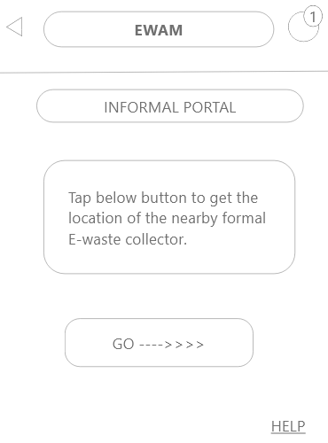
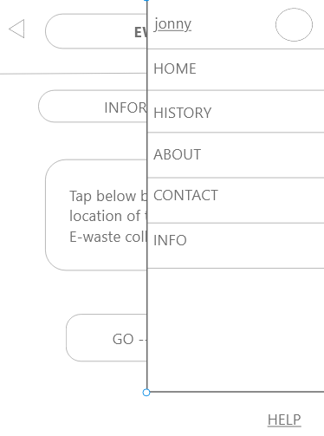
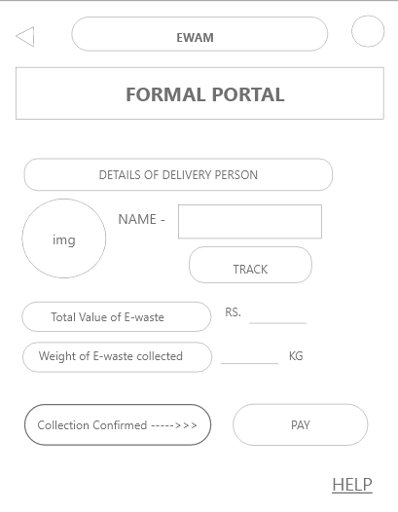

Slide 21
THANK YOU

